Slide 1

PROMOTION SYSTEM For FY 2024
PANASONIC SYSTEM NETWORKS VIETNAM CO., LTD.
Presented by: Hoang Van Hoan

Slide 2





TIMELINE:
①. PROMOTION TIME LINE
1/6
Nominate from Jul
=> Final on Mar
Implement Aug - Jan
May | Jun | Jul | Aug | Sep | Oct | Nov | Dec | Jan | Feb | Mar | Apr
1/4
Effective
4-7/3
Present &
Interview
1-6/Sep
~ 20/2
HR to follow
Register Project
GM Review
20/7
20/1
Training and Completion of Assignments
Orient-
ation
6 Months of Project
5/7
14/7
Nomin-
ation
Rank up (nominated from Oct)

Slide 3
②. PROMOTION SYSTEM
2/6
REQUIREMENT:
<~8%/Department>
Promoted if vacancy or very good performance
Be explained to BOM within current Org. Chart.
Grade-up Promotion
At least 3 years in Position.
2 latest score ≥ 9 scores.
Determine the person can already hold a higher position.
Max: 3% of Dept Headcount
Report & Test or Presentation
Rank-up Promotion
At least 1 year in Position.
2 latest score ≥9 scores.
Up 2 Rank if 10 score.
Determine the person can already hold a higher Rank.
Max: 4% of Dept Headcount.
5. Only Submit Report.

Slide 4
③. HOW TO DO PROMOTION
3/6
METHODS:
Done at least 70% Project within 6 months.
Follow guidelines and Training.
Job Title | Grade-up |  |  | Rank -up
 | Test Contents | Score | Notes | Submit Report to HR
Officer below | Promotion Test | 30 | BBP, Regulation, IQ test, Production Knowledge | + 02 pages of A4 Report + English Prefer. + About 70% project done + Sent HR - GM approved.
 | Promotion Report | 30
 | Production Knowledge | 30
 | Training Attendance | 10
Sup Above | Presentation | 30 | 10 minutes (Present) 20 minutes (Q&A) | + 01 page of A3 Report + English is a must. + About 70% project done + BOM will review finally.
 | Q & A | 60
 | Training Attendance | 10
Judge | B.O.M & GA

Slide 5
④. SOME NOTES
4/6
Request from Board of Management:
1. Make clear background of Promotion Project
(Why select theme? Why set this target? What is your role?)
2. Deeply understand of project
- Really understand all data/situation?
- Why did this project? What is benefit from Project?
- What is main PSNV issues?
3. Personal strengths:
- What is your new skills? What need to learn/train for others?
- What is career target/Future plan?
4. Others:
Format is for reference only, candidates can develop freely
but follow Regulation: 10 minutes of Presentation.

Slide 6
⑤. GUIDELINE FOR PRESENTATON
5/6
Contents
(as a logic story)
Introduction
Project Background
Analyze Issues
Set Target and
Project Plan.
4. Kaizen Activities
(4-6 detailed slides)
5. Confirm Result
(About 70% Done)
- Further Actions.
6. Development
Plan
Slide 0: Introduction & Main Contents
Topic, main contents and personal information.
Slide 1: Personal profile
- Candidate profile and personal achievement
(before joining or during period working in PSNV)
Slide 2: PSNV background
- Breakdown details of issues.
- Why need to improve? Benefits of improvement.
Slide 3: Section/Department situation
- What is your section issues?
- Target & Project plan (Aug – Feb)
Slide 4-9: Project Kaizen Activities.
- Details of improvement activities
- 4-6 Slides depend on jobs.
Slide 10: Confirm results & further Actions.
- Compare vs. Target (About 70% Project DONE)
- Further actions & Deadline (with Commitment)
Slide 11: Development Plan (if any).
- Career path for yourself
- Development Plan for your subordinates
EXAMPLE ONLY

Slide 7
⑥. PROMOTION SCHEDULE
6/6
Promotion Schedule for FY 2024
Contents | P.I.C | Deadline
① Inform Schedule for Promotion | HR | 5th Jul
② Select candidates & Submit Application Form | Sections | 14th July ’23
③ Confirm List of candidates & get BOM Approval | HR | 25th July
④ Promotion Orientation Training on Management & Working Skills | HR | 28th, July Oct~Jan
⑤ Submit Register Form of Promotion Project (Grade-up) | Candidate & Section | 1- 6th Sep
⑥ Guideline and train by sections/groups Advise Project & Follow Implementation (6 months) |  | Aug - Jan’ 24
⑦ Concerned GM/Director review for final report |  | ~ 20th Feb
⑧ Writing Test and Report (Officer below – Rank-up) Presentation & Interview (Supervisor above -Grade-up) | HR | 4~7th Mar
⑨ GD Approval and Inform Result to Candidates | HR | 27th Mar ’24
⑩ Promotion Ceremony and Promotion Letters | HR | 1st April ’24

Slide 8
Promotion Time-line (Advice)
# | Job to do | Time | Notes
1 | Lựa chọn đề tài (THEME): ~45 days (30% Công việc) Xem xét lại CV ưu tiên trong năm? Lựa chọn 3-5 ưu tiên nhất? Chốt với sếp về định hướng? | 6th Sep | Ý tưởng và đề tài phải từ bản thân (theo định hướng của bộ phận). Sẽ thực hiện ít nhất 70%.
2 | Thực hiện (CONTENTS): ~150 days (50% Công việc) Triển khai từng hạng mục Theme Actions đi kèm với xác nhận (sếp). Mở rộng thảo luận và tạo quy trình. | Sep ~ Feb | Nếu bị chệch hướng -> xác nhận với cấp trên. Chủ động actions và đưa ra ý tưởng thực thi.
3 | Viết báo cáo (Slides): ~15 days (10% Công việc) Tổng hợp các nội dung đã/sẽ làm. Triển khai theo Theme. Viết dễ sửa/thay thế (10 slides). | Nov ~Feb | Schedule với sếp In Nov: Kỹ thuật dựng PP. (Mr. Hoan đào tạo)
4 | Thuyết trình và câu hỏi: ~15 days (10% Công việc) Nắm rõ nội dung – Không lo câu hỏi | Feb ~ Mar | In Jan: KT thuyết trình. (Mr. Hoan đào tạo)

Slide 9
Management - Expertise
Management (Head):
Total management (Planning, Organizing, Staffing, Directing, and Controlling).
Has only one head position for each level.
Can be changeable from head to non-head function.
Expertise (non-Head):
Employees with valuable skills or special knowledge.
May have more than 01 pax for each level.
Employees as Non-head functions of same level.
Management (Quản lý) Head (AM/Specialist/Manager/AGMM) Vacancy after Promotion (Head) | Expertise (Chuyên môn) Non-Head (Engineer, SL (Plain)/SL, S.SL, Ex) No-Vacancy after Promotion
What is your management style? How can you manage your team? How can you do as the new position of Head (by your management)? | What is your valuable skills/strengths? How can you contribute for PSNV? How much can you contribute for Company (by your skills)?
Notes: - Change from Expertise -> Management (BOM Interview from AM above).
- Benefit are same (Specialist & Specialist (plain) because both are Non-Head.
- Different benefit are only Head and Non-Head position.

Slide 10
Schedule
# | Job to do | Time | Notes
1 | Promotion Orientation | 28/7 | Explain process
2 | Reporting Skill (1 day) | ~15/11 (Tentative) | Mr. Hoan
3 | Supervisory Skill (2 days) | 15/12 (Tentative) | Outside Trainer
4 | Presentation Skill (1 day) | 15/1/24 (Tentative) | - Mr. Hoan
Notes:
Báo cáo phải là của cá nhân bạn (ý tưởng và hoạt động).
Theo sát đề bài (70%-30%), không theo ý sếp.
Không phải là tổng hợp công việc (PR thành tích phòng).
Chủ động/phân chia thời gian (không nên dồn đến Deadline).
Chủ động trao đổi/ chốt nội dung với người liên quan.

Slide 11
9. LƯU Ý CHUNG THĂNG CHỨC 2023
8/8
Connect Activities with Management Status?
Why need?
Activities? 3 mains -> Improvement?
Why explain? Why important? (numbers)
Discuss with GM:
Promotion as advertising -> P/R with GM/BOM.
Show opinions/ Talk advanced to GMs.
Understand BOM mind as chance.
Schedule with GM (dating for guidance)
Others:
It is progress of 6-month activities (Timelines - activities).
Important: Understand & analyze Topic, real activities.
Key note: Your role in this project.

Slide 12
Sharing from BOM

Slide 13
For candidates to get promotion
◆ Having self-confidence
You have already been selected.
◆ Good chance to consider many matters
● What am I doing?
● Why do I have to do my job?
◆ Understanding the background
Company Status (Must) / Social situation
Technical Trend ..... etc
◆ Explain with Logic ～ Importance of number
Our cost is very high ・・・ How high??

Slide 14
10. Chia sẻ của tôi….
1. Đây là 1 cuộc thi nhưng hãy thoải mái
Kiểm soát căng thẳng -> khả năng của bạn với áp lực.
Năng lực tốt là đk cần, đủ là báo cáo phải OK.
Mọi tinh hoa, hãy thể hiện (Thiện cảm, qh xã hội).
2. Hãy nghĩ lớn hơn vị trí hiện tại
Sup phải nghĩ như MGR.
Đừng đổ tại hoàn cảnh dù bất kỳ khó khăn gì hãy tích cực.
Đặt mình vào các vị trí đó để xử lí tình huống.
3. Công ty có lợi gì từ hoạt động của bạn? (AM above)
Hoạt động phải gắn với Business: Nghĩ vấn đề của công ty.
Phải có cái nhìn tổng quan: Hiện tại, tương lai của vấn đề.
Nhiệt huyết, quyết tâm đến cùng khi thực hiện.

Slide 15
Good luck to all!

Slide 16
Reference

Slide 17
<Appendix 1> PROMOTION FORM
PROMOTION APPLICATION FORM
(OFFICER ABOVE)
PROMOTION APPLICATION FORM
(BELOW OFFICER)

Slide 18
<Appendix 2> PROMOTION FORM
REGISTRER FORM OF PROMOTION PROJECT
Name: | Nominated Position: | Section/Department: | Theme:
I. CURRENT ISSUES: |  | II. PLAN & TARGET FOR FY2023 (DESCRIBE PROCEDURES FOR IMPLEMENTATION OF ACTION PLAN)
II. PLAN & TARGET FOR FY2023 (DESCRIBE PROCEDURES FOR IMPLEMENTATION OF ACTION PLAN)
 |  | III. CONFIRMATION BY SUPERVISOR

Slide 19
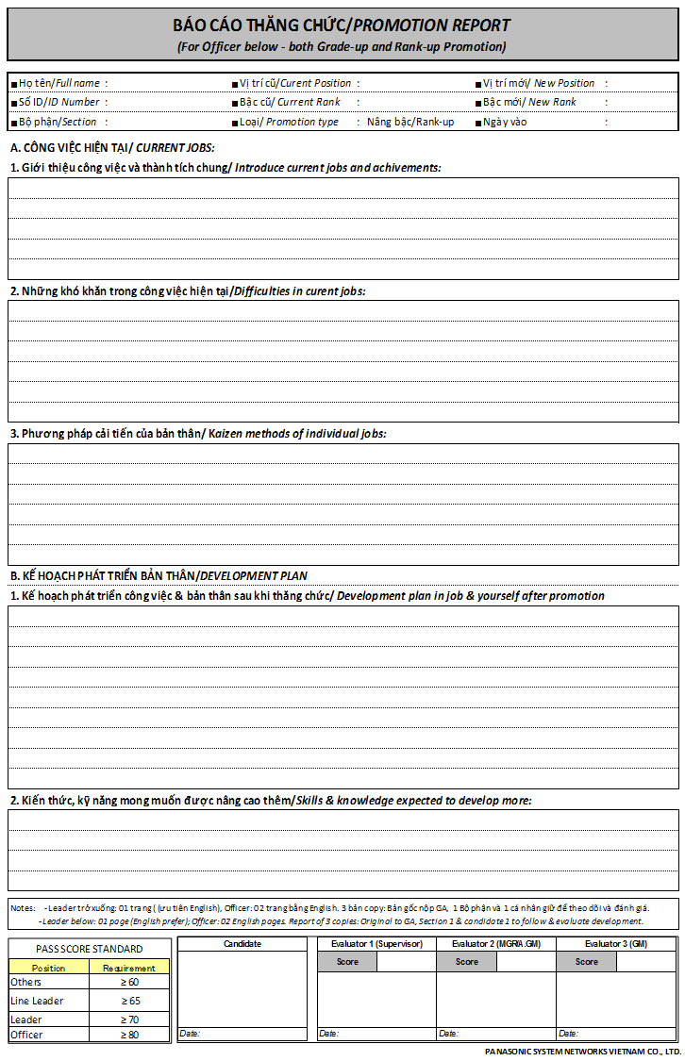
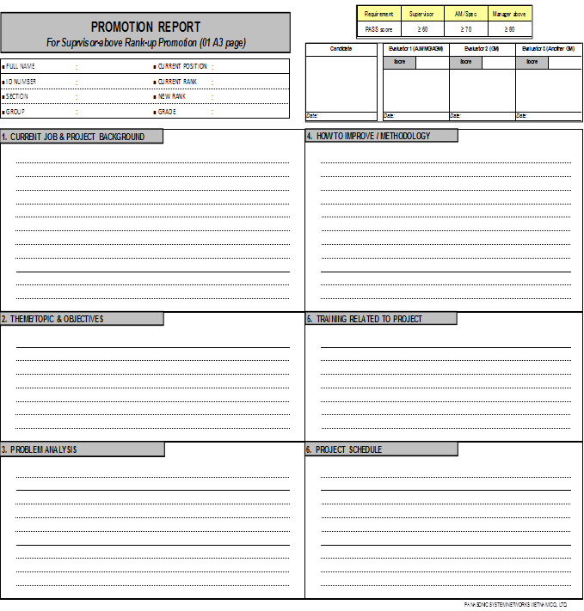
<Appendix 3> PROMOTION FORM
Promotion report (Officer below)
Rank-up for Sup above

